Slide 1
PHYS4260 Quantum Mechanics II Spring 2025
Time-Independent Perturbation Theory

Slide 2
Outline
Spin-Orbit Interaction
g-factor of the electron
Thomas precession
Fine Structure of the Hydrogen atom
Weak Zeeman Effect

Slide 3
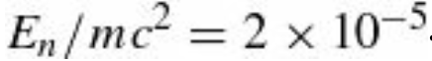
Re: The Relativistic Correction: the $\left\langle 1/r^{2}\right\rangle$ term
Evidently the relativistic correction is smaller than $E_{n}$ by a factor of about
It is important to noticed that we used non-degenerate perturbation theory in this calculation in spite of the fact that the hydrogen atom is highly degenerate. But the perturbation is spherically symmetric, so it commutes with $L^{2}$and $L_{z}$.
Moreover, the eigenfunctions of these operators (taken together) have distinct eigenvalues for the $n^{2}$ states with a given $E_{n}$. Luckily, then, the wave functions $ψ_{nlm}$ are the “good” states for this problem (or, as we say $n, l, m$are good quantum numbers) so as it happens the use of nondegenerate perturbation theory was legitimate.
From our equations we see that some of the degeneracy of the n-th energy level has lifted. But the $2l+1$ fold degeneracy in m remains. This is due to rotational symmetry, a symmetry that remains intact with this perturbation. On the other hand, the “accidental” degeneracy in $l$ has disappeared; since its source is an additional symmetry unique to the $1/r$ potential, we expect that degeneracy to be broken by practically any perturbation.

Slide 4
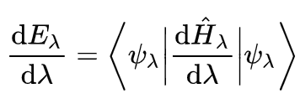
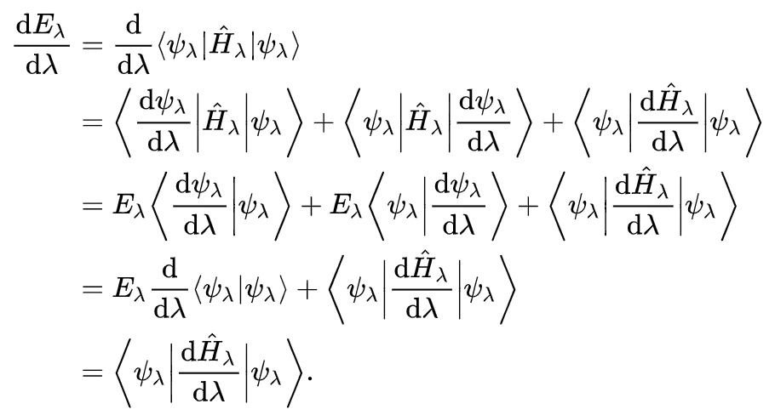
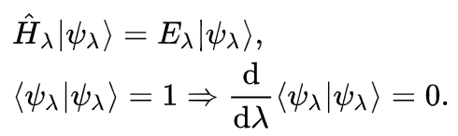
Hellmann-Feynman theorem
In QM the theorem relates the derivative of the total energy with respect to a parameter to the expectation value of the derivative of the Hamiltonian with respect to that same parameter. According to the theorem, once the spatial distribution of the electrons has been determined by solving the Schrödinger equation, all the forces in the system can be calculated using classical electrostatics.
${\hat{H}}_{λ}$ is a Hermitian operator depending upon a continuous parameter $λ$.
$|\left.ψ_{λ}\right\rangle$ is an eigenstate (eigenfunction) of the Hamiltonian, depending implicitly upon $λ$
$E_{λ}$ is the energy (eigenvalue) of the state ${\hat{H}}_{λ}$ i.e., ${\hat{H}}_{λ}$ $|\left.ψ_{λ}\right\rangle =$ $E_{λ}$ $|\left.ψ_{λ}\right\rangle$

Slide 5
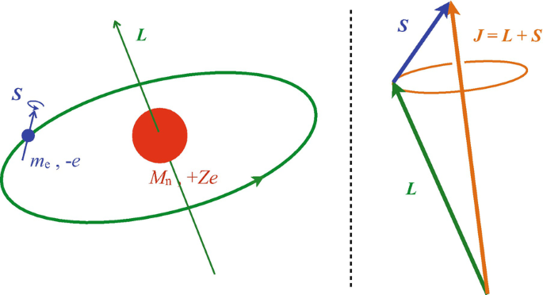
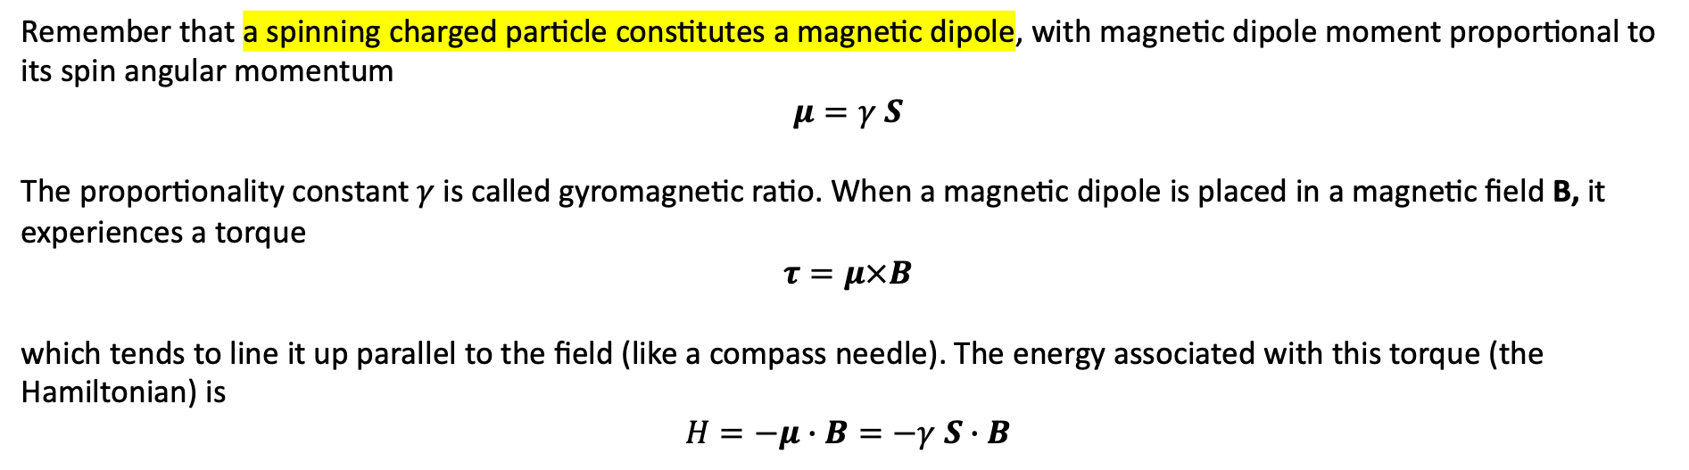
The spin-orbit interaction
Imagine the electron in orbit around the nucleus; from the electron’s point of view, the proton is circling around it. This orbiting positive charge sets up a magnetic field B, in the electron frame, which exerts a torque on the spinning electron, tending to align its magnetic moment $μ$ along the direction of the field.
Remember that a spinning charged particle constitutes a magnetic dipole, with magnetic dipole moment proportional to its spin angular momentum
$$μ=γ S$$
The proportionality constant $γ$ is called gyromagnetic ratio. When a magnetic dipole is placed in a magnetic field B, it experiences a torque
$$τ=μ×B$$
which tends to line it up parallel to the field (like a compass needle). The energy associated with this torque (the Hamiltonian) is
$$H=−μ∙B=−γ S∙B$$
(*) according to the textbook notation, boldface characters represent vectors

Slide 6
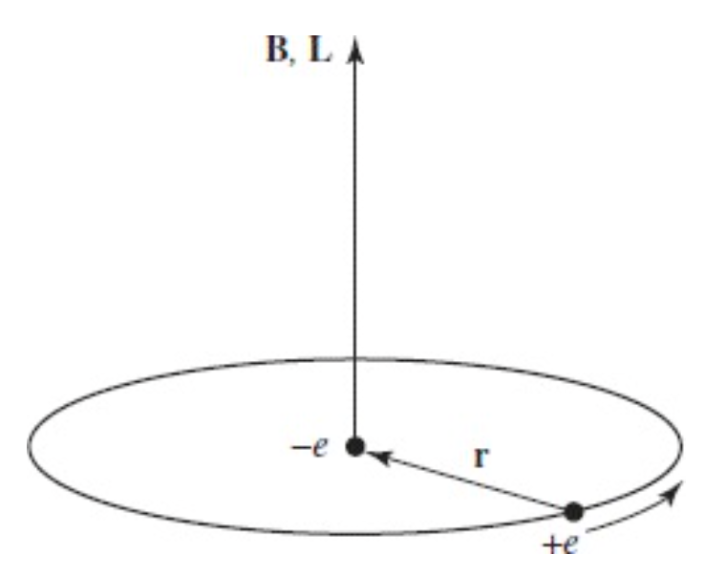
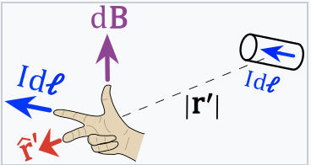
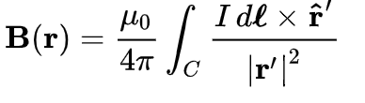
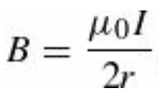
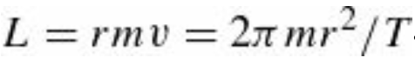
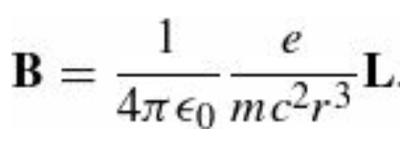
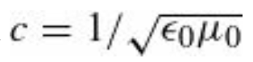
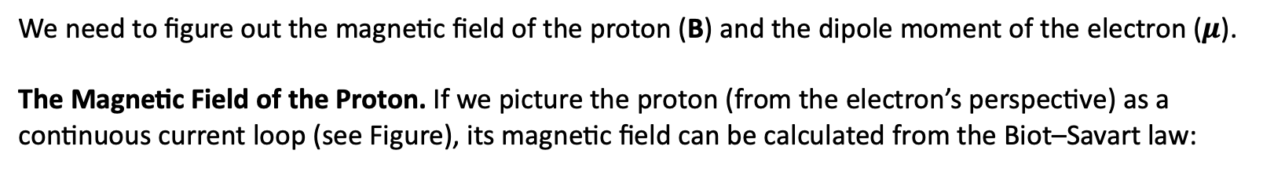
The spin-orbit interaction
We need to figure out the magnetic field of the proton (B) and the dipole moment of the electron ($μ$).
The Magnetic Field of the Proton. If we picture the proton (from the electron’s perspective) as a
continuous current loop (see Figure), its magnetic field can be calculated from the Biot–Savart law:
Hydrogen atom, from the
electron’s perspective.
with an effective current $I=e/T$ where e is the charge of the proton and T is the period of the orbit.
On the other hand, the orbital angular momentum of the electron (in the rest frame of the nucleus) is
where we used
Moreover, B and L point in the same direction (up, in the Figure), so
We used to eliminate $μ_{0}$

Slide 7
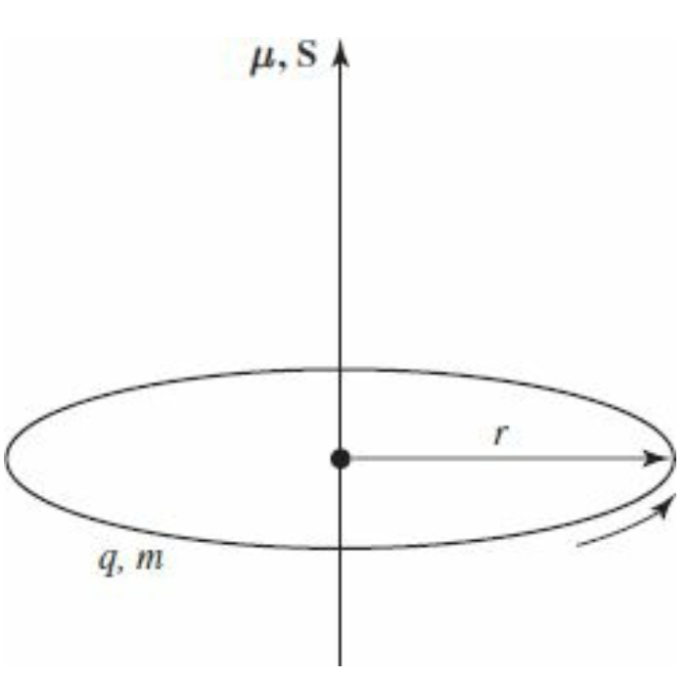
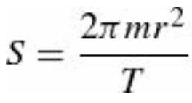
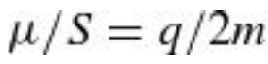
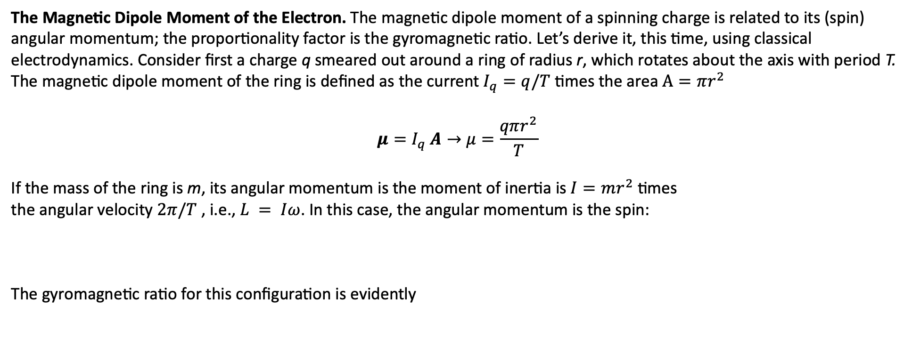
The spin-orbit interaction
The Magnetic Dipole Moment of the Electron. The magnetic dipole moment of a spinning charge is related to its (spin) angular momentum; the proportionality factor is the gyromagnetic ratio. Let’s derive it, this time, using classical electrodynamics. Consider first a charge q smeared out around a ring of radius r, which rotates about the axis with period T. The magnetic dipole moment of the ring is defined as the current $I_{q}=q/T$ times the area $A=πr^{2}$
$$μ=I_{q} A→μ=\frac{qπr^{2}}{T}$$
If the mass of the ring is m, its angular momentum is the moment of inertia is $I=mr^{2}$ times
the angular velocity $2π/T$ , i.e., $L = Iω$. In this case, the angular momentum is the spin:
The gyromagnetic ratio for this configuration is evidently
A ring of charge, rotating about its axis.

Slide 8
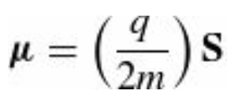
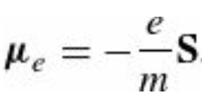
The spin-orbit interaction
Notice that it is independent of r and T. If we had some more complicated object, such as a sphere (all we require is that it be a figure of revolution, rotating about its axis), we could calculate $μ$and $S$by chopping it into little rings, and adding up their contributions.
As long as the mass and the charge are distributed in the same manner (so that the charge-to-mass ratio is uniform), the gyromagnetic ratio will be the same for each ring, and hence also for the object as a whole.
Moreover, the directions of $μ$and $S$are the same (or opposite, if the charge is negative), so
That was a purely classical calculation, however; as it turns out the electron’s magnetic moment is twice
the classical value
The “extra” factor of 2 was explained by Dirac, in his relativistic theory of the electron.

Slide 9
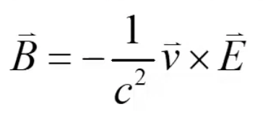

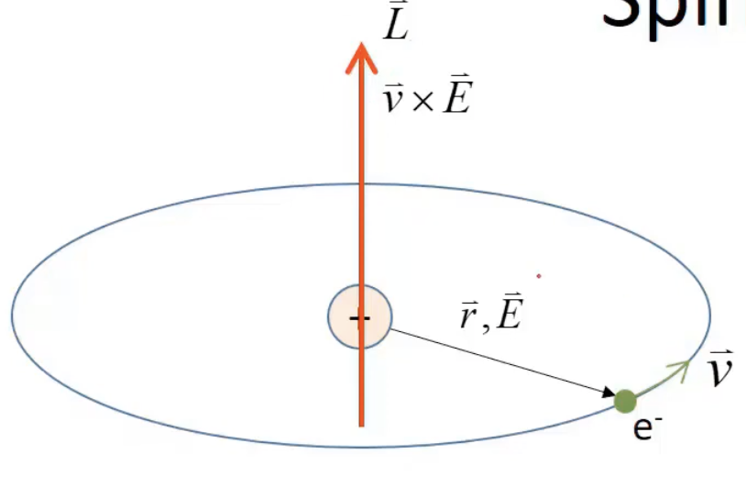
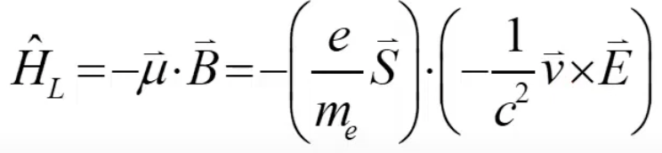
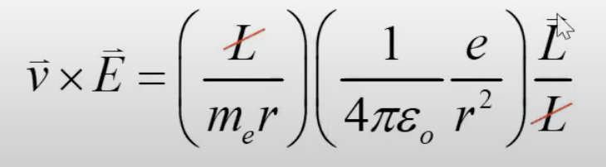
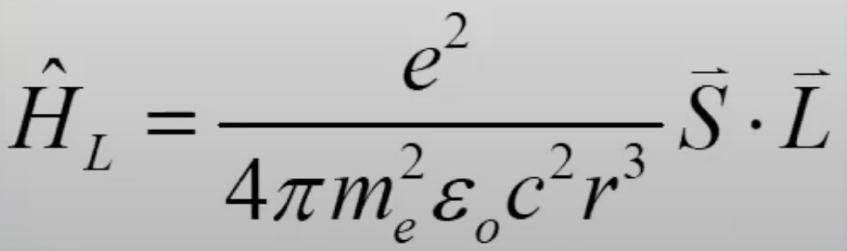
From special relativity…
The electron moves in the electric field of the nucleus. From special relativity one learns that the electron in this case feels
a magnetic field
This is from Lorentz transformations for E and B
Larmor interaction Hamiltonian

Slide 10
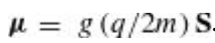
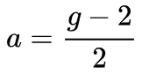
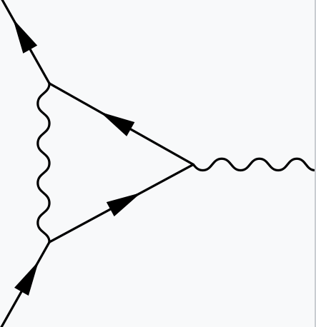
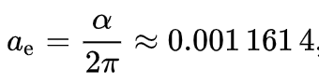
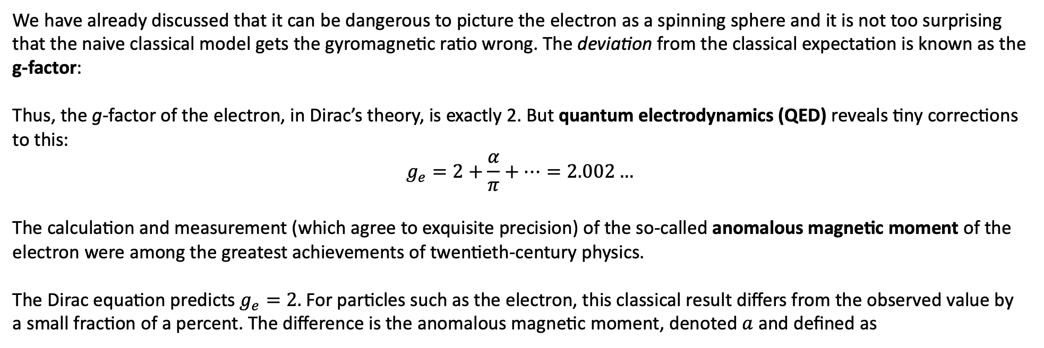
The spin-orbit interaction
We have already discussed that it can be dangerous to picture the electron as a spinning sphere and it is not too surprising that the naive classical model gets the gyromagnetic ratio wrong. The deviation from the classical expectation is known as the g-factor:
Thus, the g-factor of the electron, in Dirac’s theory, is exactly 2. But quantum electrodynamics (QED) reveals tiny corrections
to this:
$$g_{e}=2+\frac{α}{π}+⋯=2.002…$$
The calculation and measurement (which agree to exquisite precision) of the so-called anomalous magnetic moment of the electron were among the greatest achievements of twentieth-century physics.
The Dirac equation predicts $g_{e}=2.$ For particles such as the electron, this classical result differs from the observed value by a small fraction of a percent. The difference is the anomalous magnetic moment, denoted $a$ and defined as
At 1-loop

Slide 11
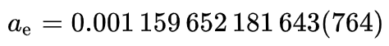
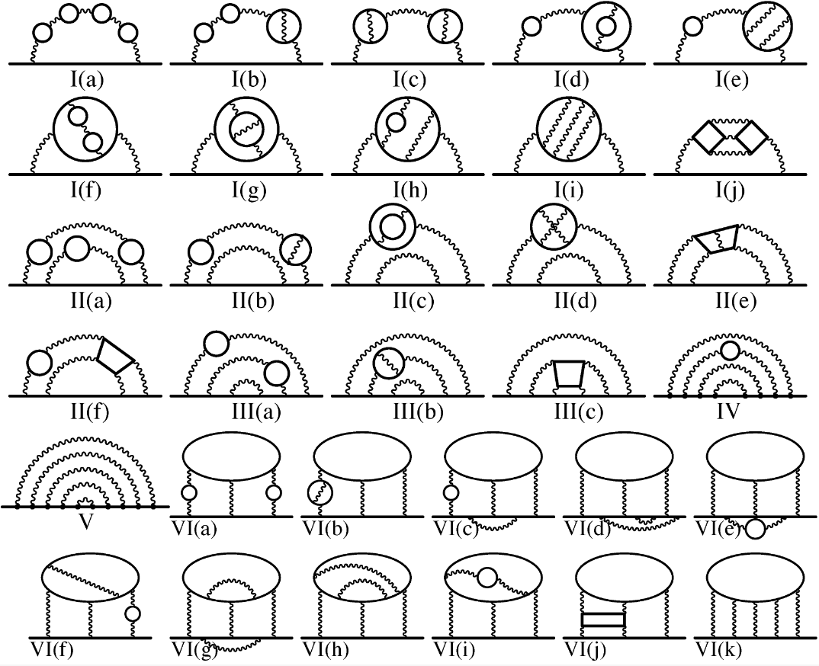
Quantum Electrodynamics (QED) test
As of 2016, the coefficients of the QED formula for the anomalous magnetic moment of the electron are known analytically up to $α^{3}$ and have been calculated up to $α^{5}$. The current experimental value and uncertainty is
The QED prediction agrees with the experimentally measured value to more than 10 significant figures, making the magnetic moment of the electron the most accurately verified prediction in the history of physics.
+ …

Slide 12
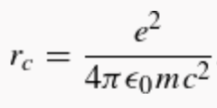
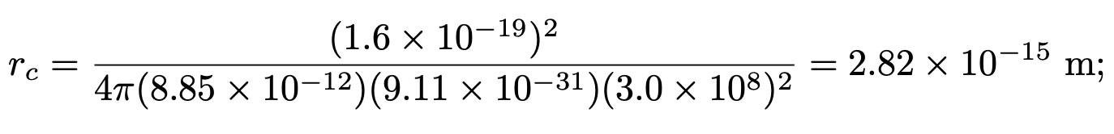
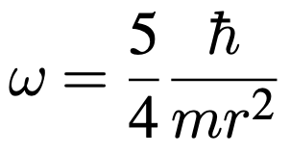
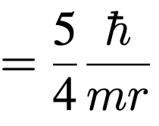
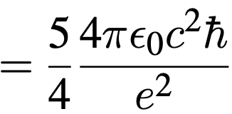
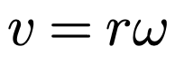
Regression: the danger of depicting the electron as a spinning sphere
If the electron were a classical solid sphere, with radius
(the so-called classical electron radius, obtained by assuming the electron’s mass is attributable to energy stored in its electric
field, via the Einstein formula $E=mc^{2}$) and its angular momentum is $1/2ℏ$ then how fast (in m/s) would a point on the
“equator” be moving? Does this model make sense? (Actually, the radius of the electron is known experimentally to be much
less than $r_{c}$ but this only makes matters worse.)
Moment of inertia $I$ for a solid sphere
Plugging in the numbers, gives a speed of 5.16 × ${10}^{10}$ m s⁻¹ which is larger than the speed of light!

Slide 13
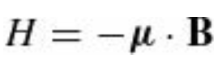
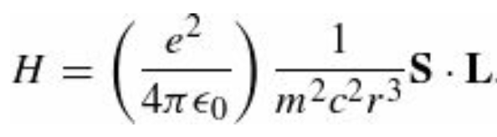
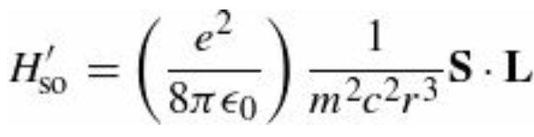
The spin-orbit interaction
To summarize, we have found that
Putting things together, one obtains
But there is a serious fraud in this calculation!
We did the analysis in the rest frame of the electron, but that’s not an inertial system—it accelerates, as the electron orbits around the nucleus.
We can get away with this if you make an appropriate kinematic correction, known as the Thomas precession. In this context it throws in a factor of 1/2:

Slide 14
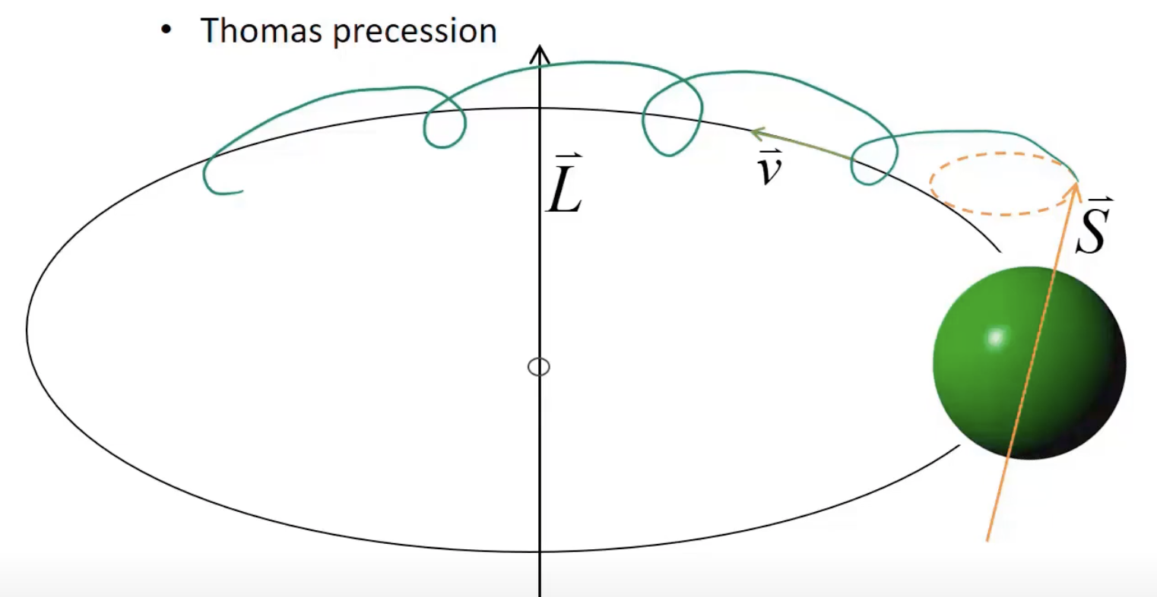
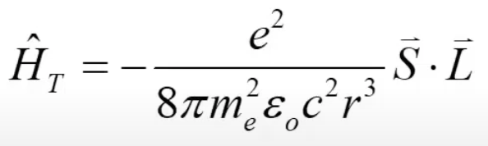
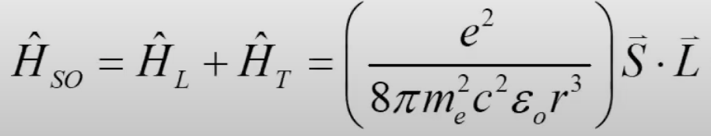
Thomas precession
One way of thinking of it is that the electron is continually stepping from one inertial system to another; Thomas precession amounts to the cumulative effect of all these Lorentz transformations.
We could avoid the whole problem, of course, by staying in the lab frame, in which the nucleus is at rest. In that case the field of the proton is purely electric, and we might wonder why it exerts any torque on the electron.
The fact is that a moving magnetic dipole acquires an electric dipole moment, and in the lab frame the spin-orbit coupling is due to the interaction of the electric field of the nucleus with the electric dipole moment of the electron.
Because this analysis requires more sophisticated electrodynamics, it seems best to adopt the electron’s perspective, where the physical mechanism is more transparent.

Slide 15
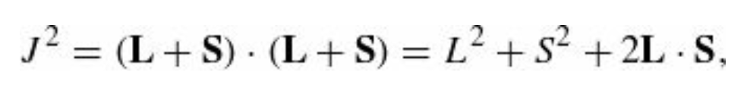
The spin-orbit interaction
This is the spin-orbit interaction; apart from two corrections (the modified gyromagnetic ratio for the electron and the Thomas precession factor—which, coincidentally, exactly cancel one another) it is just what one would expect on the basis of a naive classical model. Physically, it is due to the torque exerted on the magnetic dipole moment of the spinning electron, by the magnetic field of the proton, in the electron’s instantaneous rest frame.
Now the quantum mechanics. In the presence of spin-orbit coupling, the Hamiltonian no longer commutes with L and S, so the spin and orbital angular momenta are not separately conserved.
However, we have that $\left[{\hat{H}}_{so}^{′} , {\hat{L}}^{2}\right]=0; \left[{\hat{H}}_{so}^{′} , {\hat{S}}^{2}\right]=0; \left[{\hat{H}}_{so}^{′} ,\hat{J}\right]=0$, where $J = L+S$, and hence these quantities are conserved.
The eigenstates of $L_{z}$, and $S_{z}$ are not “good” states to use in perturbation theory, but the eigenstates of ${\hat{L}}^{2}$, ${\hat{S}}^{2}$, ${\hat{J}}^{2}$ and $J_{z}$ are.

Slide 16
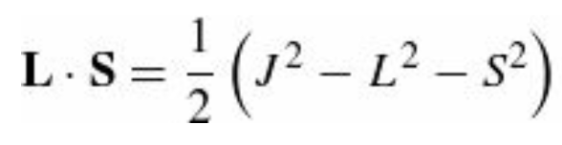
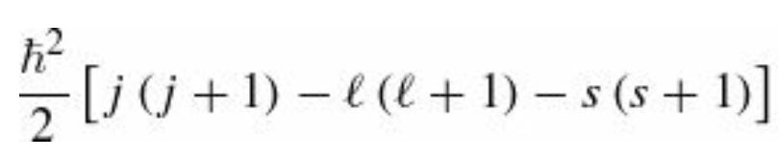
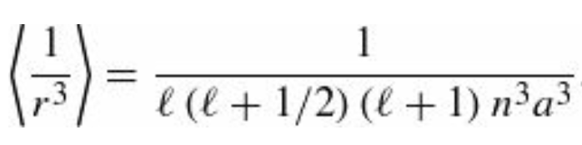
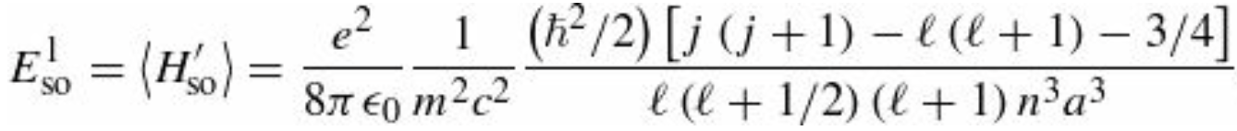
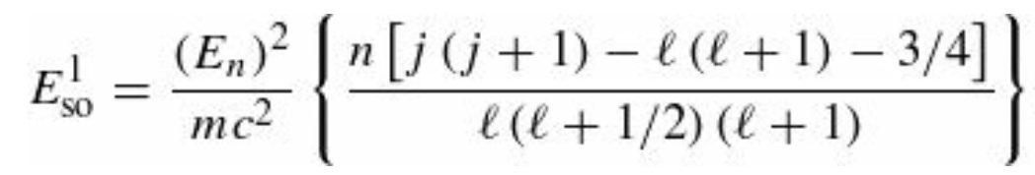
The spin-orbit interaction
Therefore, we can write and the eigenvalues of this operator are
In this case, of course $s=1/2$. At this point, we are left with the calculation of the expectation value of $\left\langle 1/r^{3}\right\rangle$.
The explicit calculation gives
and we conclude that
or, expressing it all in terms of $E_{n}$

Slide 17




Recap: The spin-orbit interaction
It is remarkable, considering the totally different physical mechanisms involved, that the relativistic correction and the spin-orbit coupling are of the same order
In fact, for the relativistic corrections we have found
Adding them together, we get the complete fine-structure formula
Combining this with the Bohr formula, we obtain the grand result for the energy levels of hydrogen, including fine structure:

Slide 18



The spin-orbit interaction
Fine structure (i.e., relativistic + spin-orbit corrections) breaks the degeneracy in $l$ (that is, for a given n, the different allowed values of $l$ do not all carry the same energy), but it still preserves degeneracy in j (see figure). The z-component eigenvalues for orbital and spin angular momentum ($m_{l}$ and $m_{s}$) are no longer “good” quantum numbers—the stationary states are linear combinations of states with different values of these quantities; the “good” quantum numbers are $n, l, s, j$, and $m_{j}$.
And we are going to explore this now

Slide 19




The Zeeman Effect
When an atom is placed in a uniform external magnetic field $B_{ext}$ the energy levels are shifted. This phenomenon is known as the Zeeman effect. For a single electron, the perturbation is
magnetic dipole moment associated with electron spin
dipole moment associated with orbital motion
The nature of the Zeeman splitting depends critically on the strength of the external field in comparison with the internal field that gives rise to spin-orbit coupling. We have two cases:
$B_{ext}≪$ $B_{int}$ then fine structure dominates, and $H_{z}^{′}$ can be treated as a small perturbation.
$B_{ext}≫$ $B_{int}$ then the Zeeman effect dominates, and fine structure becomes the perturbation.

Slide 20


The Zeeman Effect
To summarize: In a magnetic field, the perturbation term is
where $\vec{μ}$ is the magnetic moment of the atom. The magnetic moment consists of the electronic and nuclear parts; however, the latter is many orders of magnitude smaller and will be neglected here. Therefore,
where $μ_{B}$ is the Bohr magneton, $\vec{J}$ is the total angular momentum of the electron, and $g$ is the Landé g-factor, which we will later denote with $g_{J}$. We have seen that a more accurate approach is to take into account that the operator of the magnetic moment of an electron is a sum of the contributions of the orbital angular momentum $\vec{L}$ and the spin angular momentum $\vec{S}$ with each multiplied by the appropriate gyromagnetic ratio
Where $g_{l}=1$ and $g_{S}≈2.0023193$ (the latter is called the anomalous gyromagnetic ratio; the deviation of the value
from 2 is due to the effects of quantum electrodynamics).

